Slide 1
Tropical Fruit &
Grape Wines
-Est. 2012-
“Celebrating With You.”

Slide 2
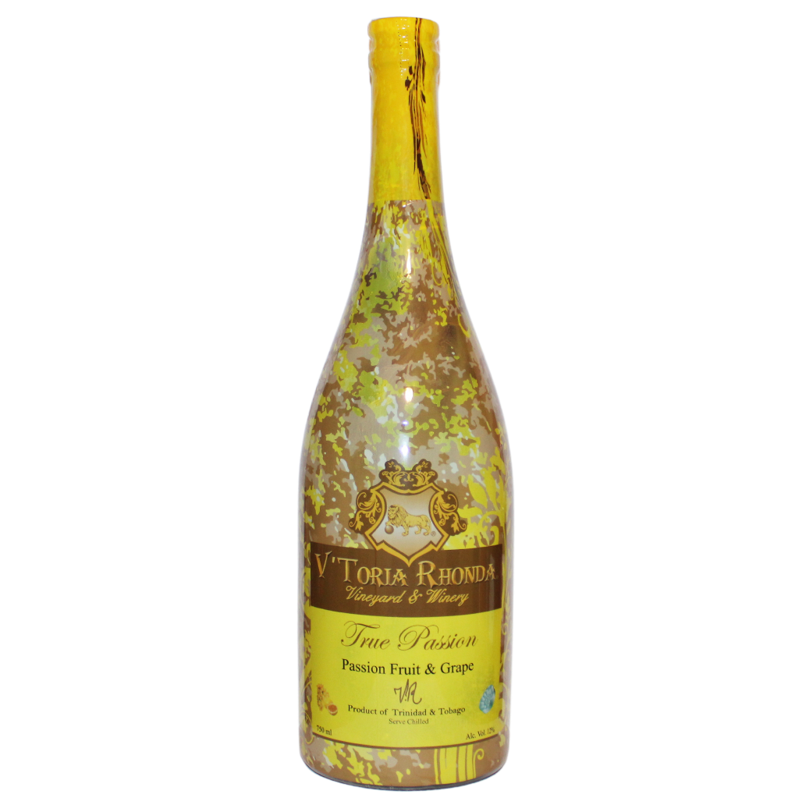
TRUE PASSION WINE
Passion Fruit & Sauvignon Blanc
Tasting Notes
“A fascinating wine that is intensely tropical. with the
right dish, maybe grilled shrimp and papaya salad, it would be spectacular.“ - USA Wine Ratings
Origin
Product of Trinidad & Tobago.
Description
Type: Sweet White Wine
Taste: Passion Fruit and Guava.
Aroma: Passion Fruit.
Bottle: Size: 750 ml.
Alcohol: 12%.
Production
Made from Passion Fruit and Sauvignon Blanc that greatly complements each other.
How to Serve
Best served at 42º F in an elegant wine glass.

Slide 3
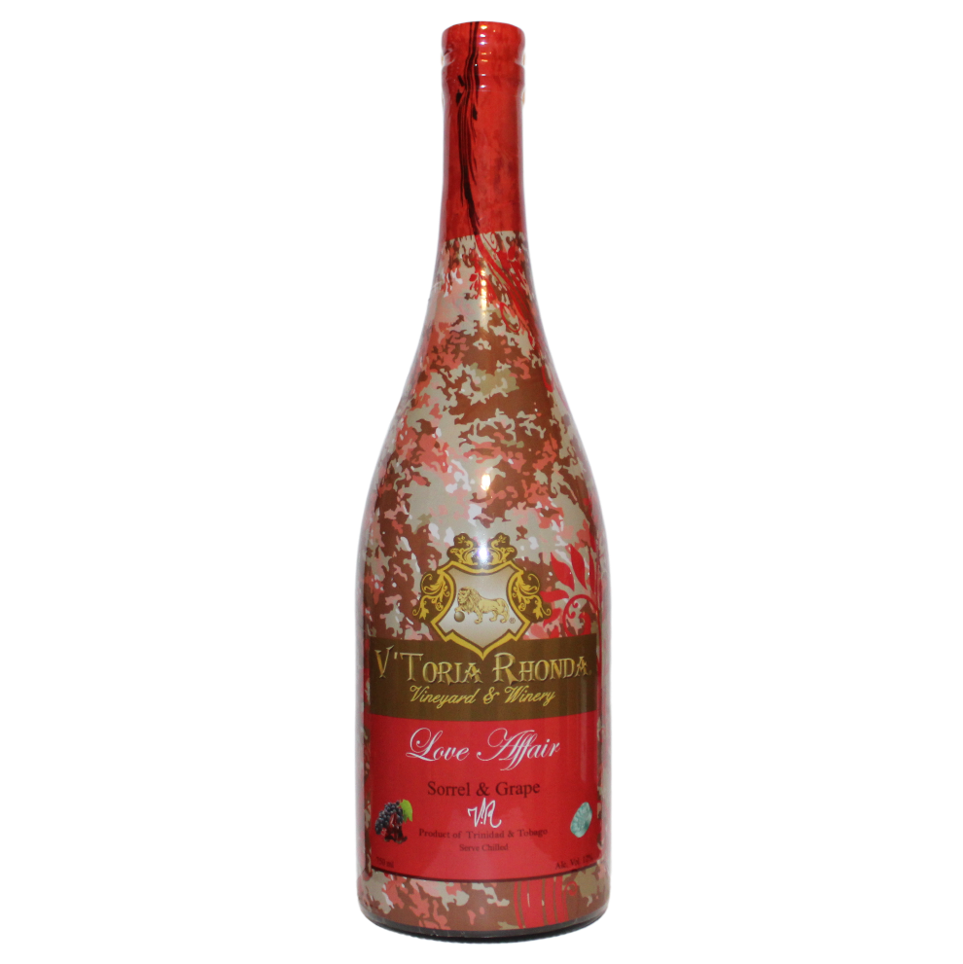
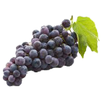
LOVE AFFAIR WINE
Tasting Notes
Our Love Affair Wine, produced from Sorrel, Malbec grape, and natural flavours; springs a rich colour throughout the wine and cherry flavour.
Sorrel & Malbec
Origin
Product of Trinidad and Tobago
Production
Crafted from Sorrel and Malbec.
Description
Color:
Taste:
Aroma:
Bottle Size:
Alcohol:
Red Wine
Sorrel and cherry Sweet cherry, red plum 750 ml
12%
How to Serve
Best served at 42º F in an elegant wine glass.

Slide 4
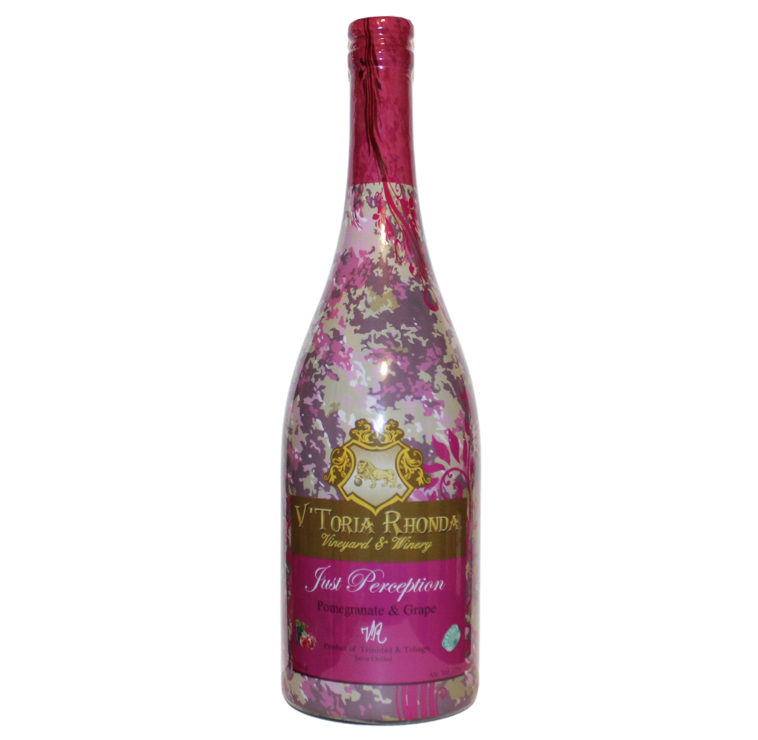
PERCEPTION WINE
Pomegranate & Zinfandel
Tasting Notes
“This is a lusciously sweet and spicy red wine with a delightful strawberry-licorice character. It makes a charming aperitif or paired with light fruit desserts.” - USA Wine Rating
Origin
Product of Trinidad and Tobago
Production
Made from Pomegranate and Zinfandel
Description
Type:
Taste:
Aroma:
Bottle Size:
Alcohol:
Red Wine Pomegranate
Sweet cherry and red plum 750 ml
12%
How to Serve
Best served at 42º F in an elegant wine glass.

Slide 5
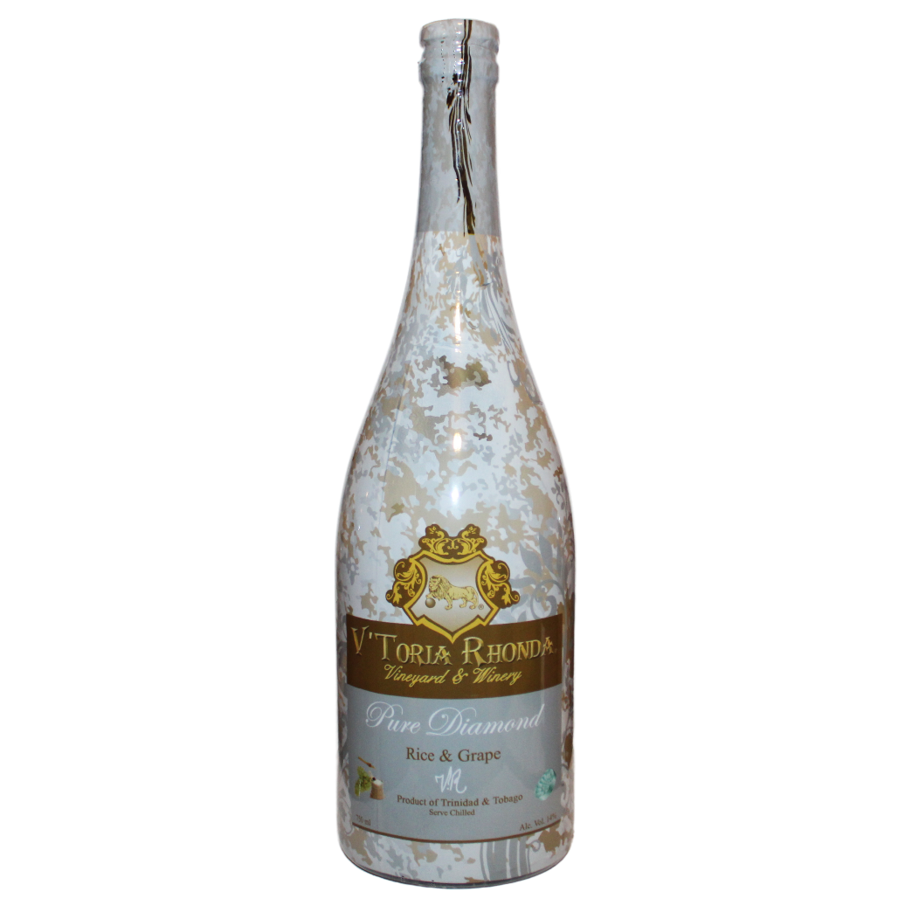
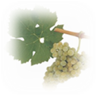
PURE DIAMOND WINE
Rice & Riesling
Tasting Notes
“Aromas of mango, rice pudding, and honeyed apple. A sweet palate with candied tropical fruits. The wine is perfect for summer months due to its refreshing qualities.”
- USA Wine Ratings
Origin
Product of Trinidad and Tobago
Production
Riesling and Rice are married together during primary fermentation.
Description
Type:
Taste:
Aroma:
Bottle Size:
Alcohol:
White Wine
Smooth taste
Hints of pear and peach. 750 ml
14%
How to Serve
Best served at 42º F in an elegant wine glass.
5

Slide 6
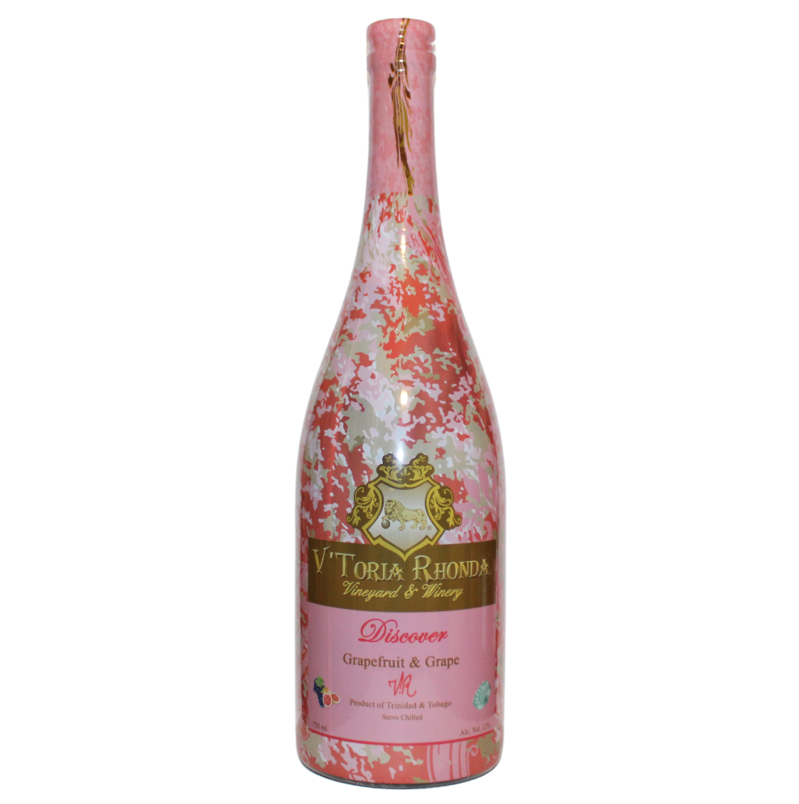
DISCOVER WINE
Grapefruit & Merlot
Tasting Notes
“Spicy notes of clove, star anise and freshly ground nutmeg. Palate explodes with notes of red fruits, baking spices and smoked meats. Refreshing, pithy finish cuts the sweetness. Pair alongside barbecued meats..” - USA Wine Rating
Origin
Product of Trinidad and Tobago
Production
Made from Grapefruit and Merlot.
Description
Type:
Taste:
Aroma:
Bottle Size:
Alcohol:
Red Wine
Citrus and spice
Grapefruit
750 ml
12%
How to Serve
Best served at 42º F in an elegant wine glass.

Slide 7
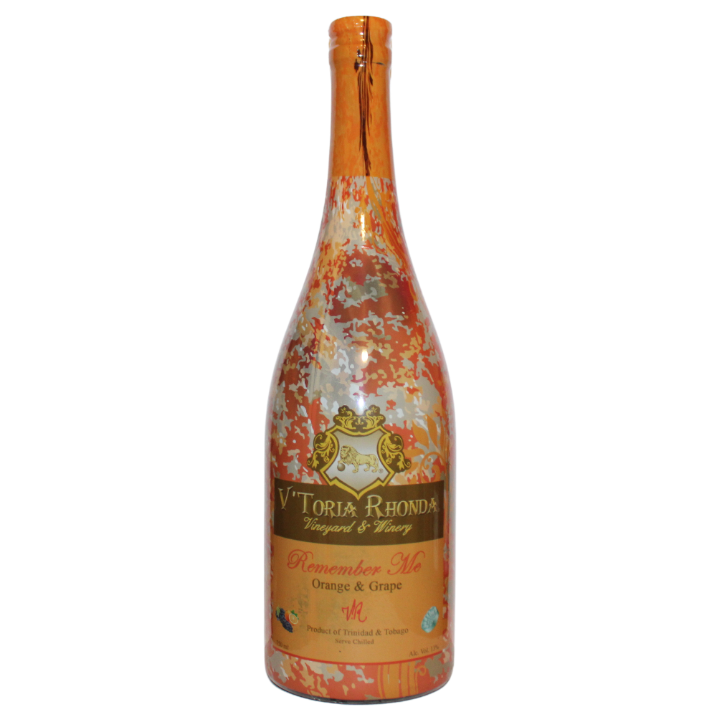
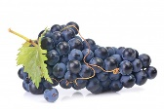
REMEMBER ME WINE
Orange & Muscat
Tasting Notes
“Aromas of mango, rice pudding, and honeyed apple. A sweet palate with candied tropical fruits. The wine is perfect for summer months due to its refreshing qualities.”
- USA Wine Ratings
Origin
Product of Trinidad and Tobago
Production
Made from Orange and Muscat.
Description
Type:
Taste:
Aroma:
Bottle Size:
Alcohol:
White Wine
Smooth taste
Hints of pear and peach. 750 ml
13%
How to Serve
Best served at 42º F in an elegant wine glass.
7

Slide 8
Product Facts
We offer a new experience to wine drinking where all our wines are crafted from tropical fruits and grape varietals.
We are the only winery with a passion fruit vineyard in the Caribbean.
Innovative packaging. We use the full-
bodied shrink sleeve that shows a 360- degree label on the bottle which is eye- catching on the shelves.
Our corks consist of the Zork Closures and the Vino-Lok, both also innovative and simplifies the task of opening a bottle of wine.
Our company is ready to supply the growing trend of exotic, high quality, innovative wines.
Our award-winning wines has received gold, silver and bronze medals at Sommelier
Choice Awards and USA Wine Ratings
competitions.
Wines are filtered three to four times before bottling.
Storage in a temperature- controlled room.
Aged in oak barrels.
2022 True Passion will be our first Estate Wine.

Slide 9
Our Story
V'Toria Rhonda Vineyard & Winery Ltd, was established in 2012 by Nekisha Rhonda Charles with the goal of crafting award-winning, innovative, high-quality wines from exotic tropical fruits infused with various grape varietals.
It began as follows, "My Mother, Yvonne began making wine in 1962 with her village neighbours as a hobby and continued doing so as early as I can remember. At the age of 13, my mother had a jar of rice wine stored in her cabinet and offered me a taste, I took a liking to it immediately and decided to have a little more later that night when everyone was asleep.” By Nekisha Charles
Fast forward, in 1999, her senior year in university, she had the opportunity of participating in the Exchange Program in London and was able to experience different cultures. Upon her return home, said to mom, "Mom, I am going to start a winery and name it after my grandmother, Mrs. Victoria Richardson Harper." Soon after, her mother was showing her how to make her first wine from oranges.
The company currently has four wine, Love Affair Wine - Sorrel & Concord, True Passion Wine - Passion
Fruit & Sauvignon Blanc, Perception Wine - Pomegranate & Zinfandel and our newest Pure Diamond Wine
- Rice & Riesling, with Remember Me Wine – Orange & Muscat and Discover Wine – Grapefruit & Merlot being released in 2022. In January 2020, the company established a passion fruit vineyard and will release their first estate True Passion Wine in 2022.
Defining moment, “A few years after establishing the company, I found a letter from my grandmother Victoria, where she signed “VR”, V for Victoria, her first name, R for Richardson-her maiden's name and I immediately recognized that these are the initials of my company.” By Nekisha Charles
Today her grandmother’s initials “VR” has been extracted from that letter and printed on every wine bottle.

Slide 10
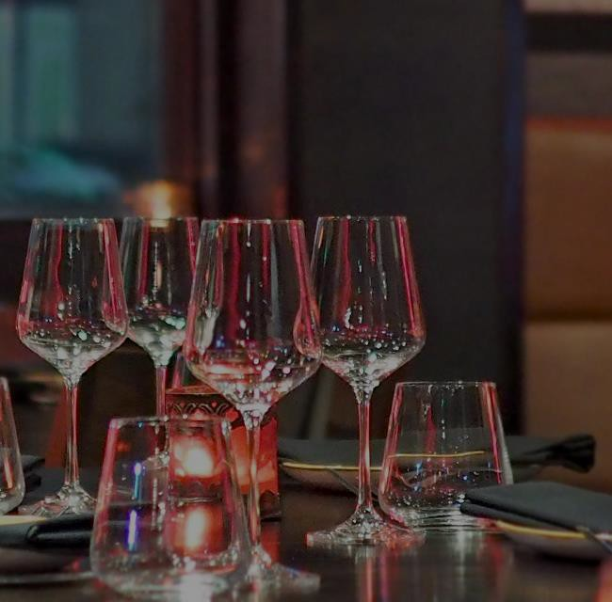
THANK YOU!
Nekisha Charles
Founder & CEO
Nekisha@vtoriarhondawinery.com
1 929 343 1577
1 868 489 2713

